Slide 1


MANAGED
UNIFORM
PROGRAMS
A smarter way to handle company uniforms - from sourcing to service.
www.KevinsWW.com

Slide 2

Thinking About a Managed Uniform Program for Your Company?
Uniforms aren’t just apparel — they’re infrastructure.
At Kevins Worldwide®, we design and manage uniform programs that support complex organizations with multiple locations, roles, and compliance requirements. Our approach combines strategic sourcing, inventory control, technology, and hands-on program management to deliver consistency, cost control, and operational efficiency.
We don’t simply supply uniforms:
  We build systems that work — and we manage them for you.
  Enterprise-ready program structure
  Dedicated account teams
  90-minute response time commitment
  Scalable solutions built around your organization

Slide 3
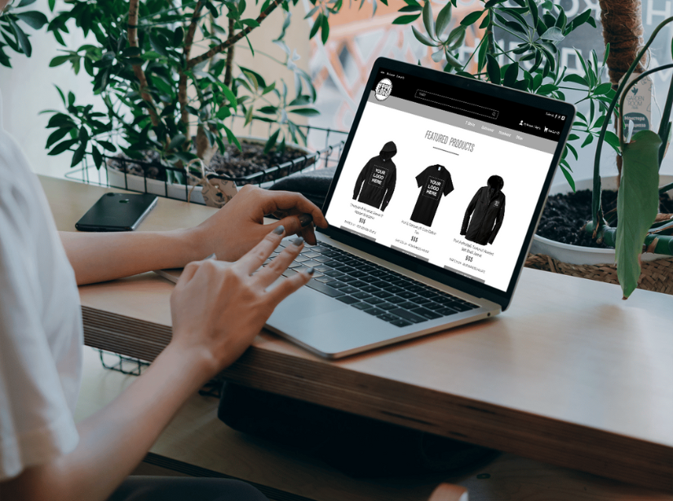
Common pain points we solve:
The Challenges of Traditional Uniform Programs
  Decentralized ordering across departments or locations
  Inconsistent branding and product selection
  Manual tracking of inventory and spend
  Overstocking, stockouts, or unmanaged replenishment
Many organizations start with good intentions but over time, uniform programs become fragmented and difficult to manage. Multiple vendors, inconsistent products, and manual ordering processes create inefficiencies that impact both cost and brand consistency.
Without a centralized strategy, uniform management turns into a reactive process.

Slide 4
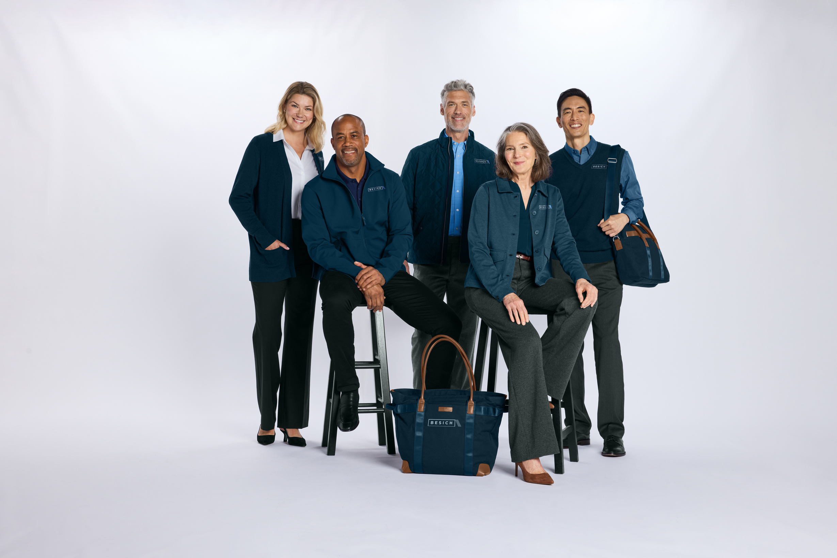
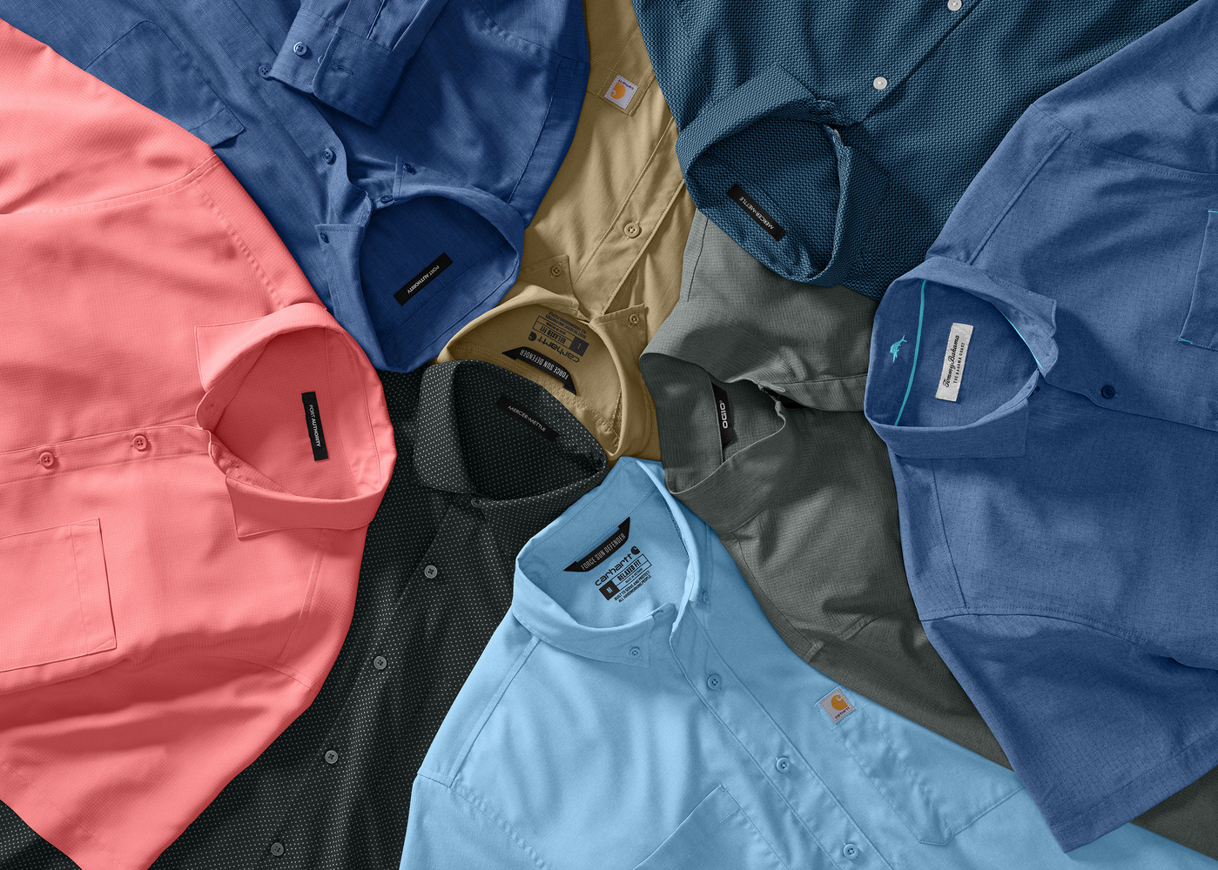
Our Strategic Approach
We begin with discovery. Before recommending products or platforms, we evaluate your existing process, workforce structure, approval flows, and distribution model. From there, we design a program tailored to how your organization operates.
This ensures the solution fits your internal workflows — not the other way around.
Our strategic framework includes:
  Uniform policy alignment and role-based product planning
  Budget structure and approval workflow design
  Inventory forecasting and replenishment modeling
  Multi-location coordination and scalability planning

Slide 5

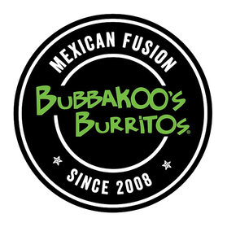
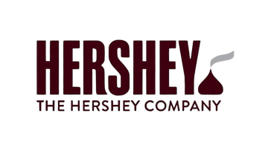
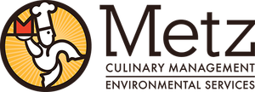
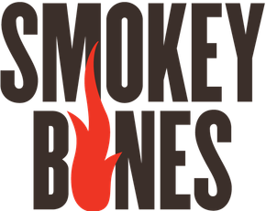
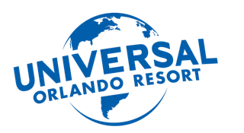
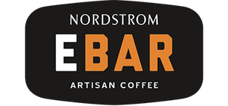
Program components include:
  Strategic sourcing and curated product selection
  Decoration services (embroidery, screen printing, DTF)
  Warehousing and inventory management
  Customized online uniform ordering platform
  Individual fulfillment to employees or bulk facility shipments
  Reporting and analytics for program oversight
What’s Included in a Managed Uniform Program
Our managed uniform programs are comprehensive — eliminating the need to coordinate multiple vendors or internal teams. We centralize sourcing, provide in-house decoration, and oversee inventory & distribution under one structured program.
The result is one cohesive system instead of scattered efforts.
Some of our uniform clients:

Slide 6
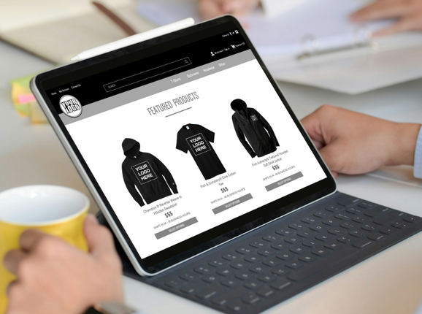

Technology That Supports Control
Each store is tailored to your brand standards, workforce roles, and internal approval processes. Employees see only what’s approved for their position, while leadership maintains clear oversight of budgets, ordering activity, and program compliance.
A successful uniform program requires more than product availability — it requires structure, visibility, and accountability.
Customize Needs
Behind the scenes, real-time inventory tracking and reporting provide the transparency needed to forecast demand, reduce waste, and prevent stock disruptions. The result is a uniform program that feels seamless to employees and strategic to leadership.

Slide 7

Operational & Financial Benefits
Operational Efficiency at Scale
As your workforce grows or shifts across locations, your uniform program adapts without adding internal strain.
A managed uniform program doesn’t just improve ordering — it improves efficiency across your organization. By centralizing procurement and introducing structure, companies gain measurable improvements in both cost control and time savings.
Uniforms become predictable, not reactive.
Data-Driven
Cost Control
Benefits you can expect:
  Reduced administrative workload
  Improved brand consistency across all locations
  Lower waste through inventory forecasting
  Faster turnaround times
  Clear visibility into spend and program performance
Clear reporting and usage visibility turn uniform spend into a measurable, manageable investment.

Slide 8

Ongoing
Management & Support
Dedicated Account Management
90-Minute Response Time Commitment
You’ll have a consistent point of contact who understands your program inside and out and proactively manages it on your behalf.
Our team responds quickly and reliably, ensuring your questions and requests never sit unresolved.
Strategic Reviews & Performance Insights
Inventory Monitoring & Reorder Recommendations
We regularly evaluate your program’s performance, identify opportunities for improvement, and align with your evolving goals.
We actively track inventory levels and recommend replenishment before stock becomes an issue, preventing disruption across locations.
Our partnership doesn’t end at launch. We actively manage your program, monitor inventory levels, recommend replenishment, and provide continuous support. We operate as an extension of your team — not just a supplier.

Slide 9
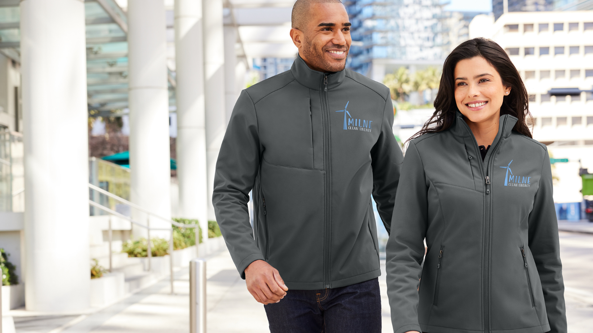

Let’s Build a
SMARTER
Uniform Program
Uniform management should feel organized, predictable, and scalable — not reactive or chaotic. Kevins Worldwide® brings together product expertise, technology, and operational discipline to create uniform programs that work.
Let’s evaluate your current process and design a program built around your organization’s needs.
www.KevinsWW.com
Info@KevinsWW.com

