Slide 1

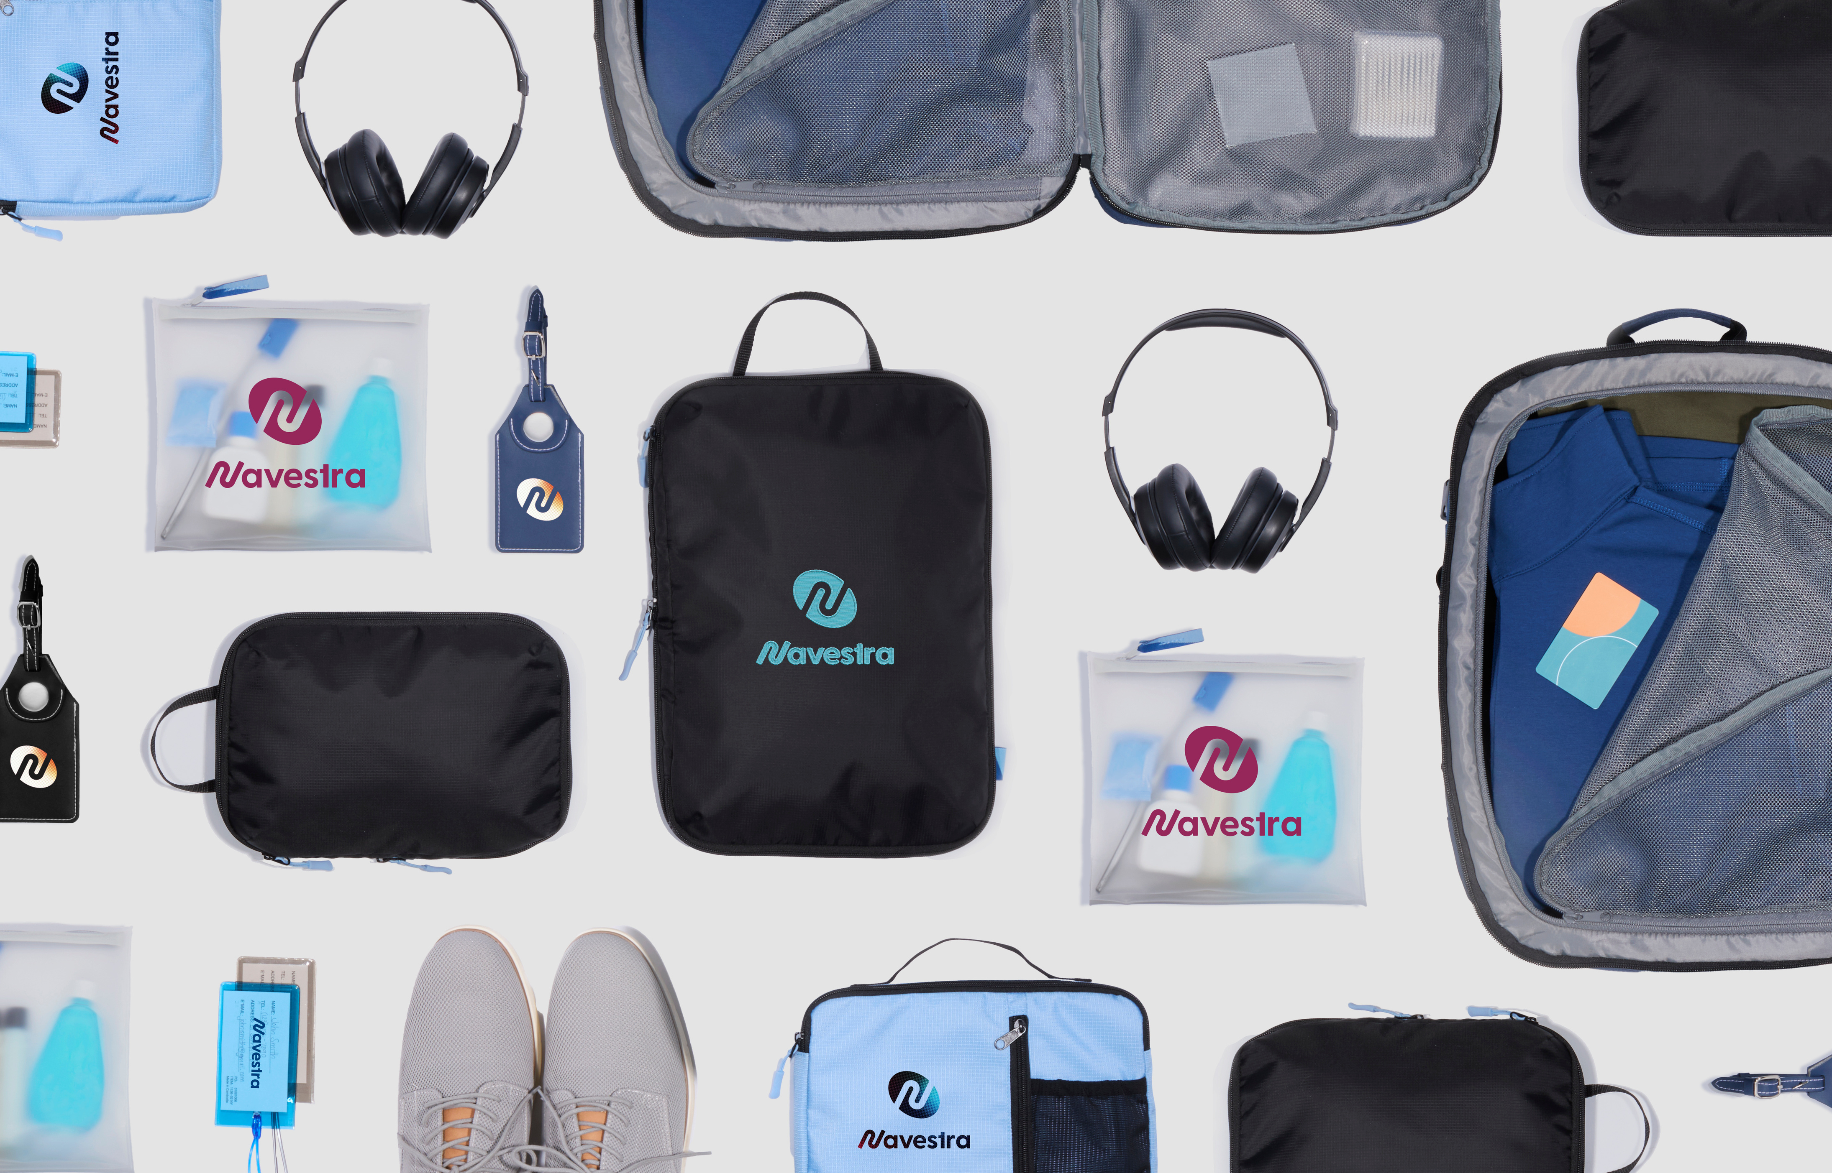



COMPANY
SWAG STORES
Easy as 1,2,3
www.KevinsWW.com

Slide 2
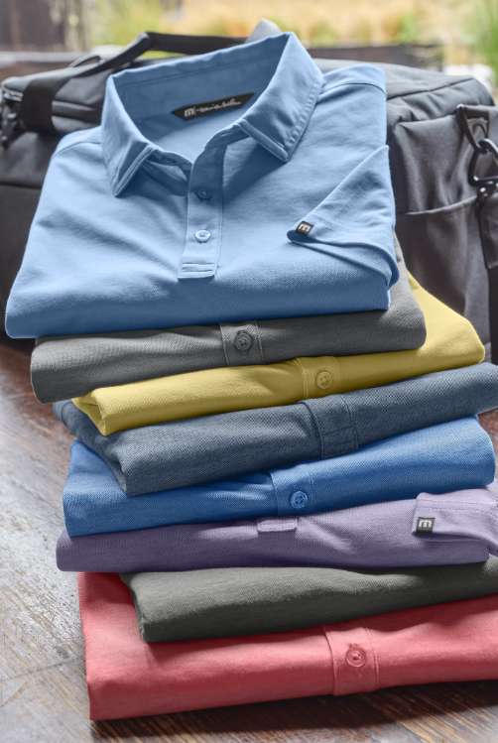

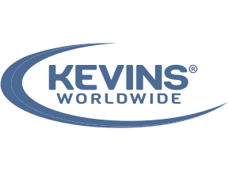

Swag Shouldn’t Be Hard
Ordering branded merchandise sounds simple… until it isn’t.
Different teams ordering different products. Logos used inconsistently. Budgets become unclear, and inventory is either sitting unused or unavailable when you need it most. What starts as a small task quickly turns into a fragmented, time-consuming process.
At Kevins Worldwide®, we’ve seen this firsthand—and we’ve built a better way. By turning swag into a structured, managed system, we help organizations eliminate the chaos and bring consistency, control, and simplicity back to branded merchandise.

Slide 3
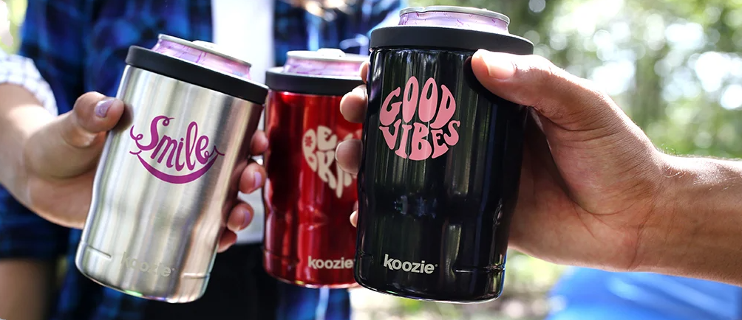
What If Swag Worked Like a System?
Imagine one place where every employee, department, and location goes for branded merchandise—without confusion, without back-and-forth, without guesswork.
A system where:
  Only approved products are available
  Budgets are built in
  Orders follow your internal processes
  Inventory is tracked automatically
That’s what a Company Swag Store is meant to be.

Slide 4




Your Swag Store, Built Around Your Company
Built Around Your Structure
Your store reflects how your company is organized—by department, role, or location—so ordering feels intuitive and aligned with your internal workflows.
Designed for Control
We incorporate budget parameters, approval flows, and product access rules to ensure every order stays compliant and on-brand without slowing your team down.
Customized to Your Brand
From curated product selections to the look and feel of the storefront, every detail is tailored to represent your brand consistently across all teams.

Slide 5
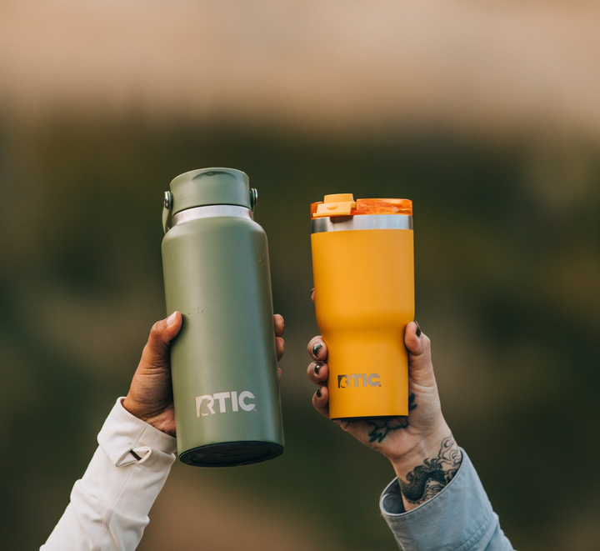
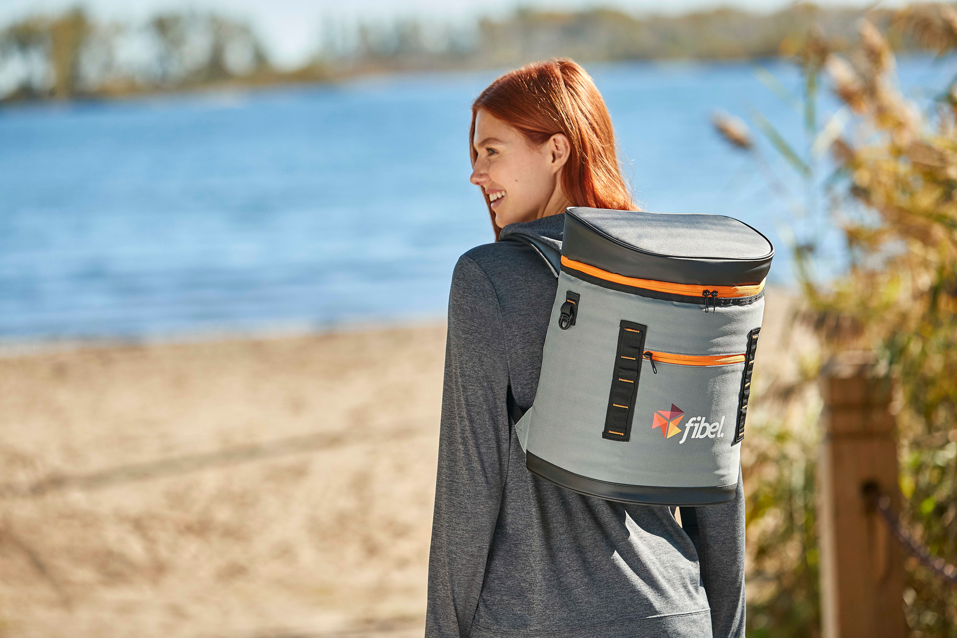
Types of Features We See Clients Ask For
Made to Order
Fulfillment
Redemption/Rewards
No upfront inventory is required; items are produced and shipped only when ordered, allowing for low-risk, smaller product selections
These store and ship large inventory, ideal for large organizations with regular demand for uniforms or onboarding
Dedicated to employee recognition, this model allows staff to choose their own gifts
A company swag store isn’t just a place to hold products—it’s built to support how your business actually runs. Whether you’re onboarding new hires, recognizing employees, gearing up for events, or supporting your sales team, everything lives in one reliable place. No more last-minute scrambling—just a simple, repeatable system that keeps your brand consistent and your team ready to go.

Slide 6
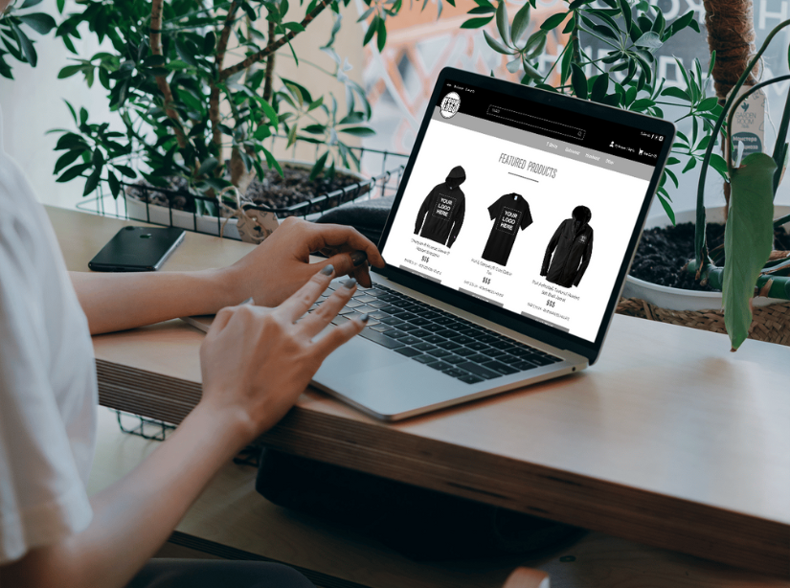
Choosing Your Store
As one of the earliest adopters of company swag stores, Kevins Worldwide has been providing clients with the eCommerce solutions they need, at prices they can afford, with the highest level of service for years.
Choosing the type of store you need has never been easier - whether you’re just starting out or facing challenges with your current store, our team is here to help.
01
02
03
Explore
Store Options
Choose Your
Store Level
Customize to Fit
Your Needs
Kevins Worldwide offers multiple store types and levels to match the unique needs of your business
Once we determine your webstore goals, we work with you on selecting your webstore level. Choose the store level that works best for your program goals
We keep clients in control, allowing you to add the store elements and items you believe best meet your program needs, with suggestions from your eCommerce team for the best results

Slide 7
Your Store - A Managed Program
A swag store without support is just another tool to manage. We handle the infrastructure behind it so your team doesn’t have to.
Strategic Product Sourcing
In-House Decoration & Quality Control
Inventory & Warehousing
Fulfillment & Distribution
We curate products that align with your brand, audience, and use cases—so every item feels intentional, not random.
With decoration handled internally, we ensure consistency, accuracy, and quality across every order.
We manage inventory levels, storage, and replenishment—eliminating the need for your team to track or store products.
From individual shipments to large-scale rollouts, we handle pick, pack, and delivery so your products get where they need to go—on time and on brand.

Slide 8
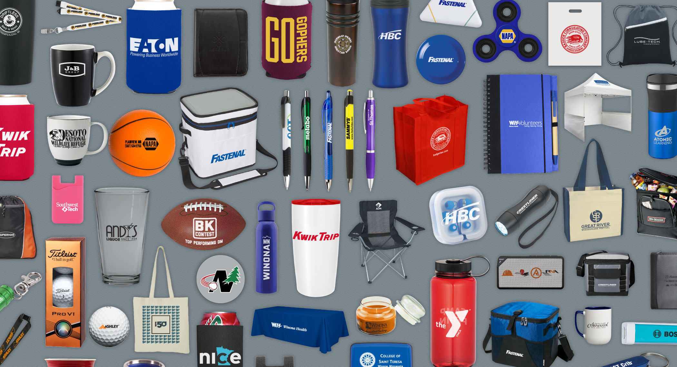
Control Without Friction
A great swag program shouldn’t force you to choose between ease of use and organizational control—but too often, it does. Our swag stores are designed to strike the right balance, giving employees a simple, intuitive ordering experience while providing leadership with the structure, visibility, and budget control needed to keep everything aligned—without adding friction to the process.
Employees Get:
Leadership Gets:
  A simple, familiar ordering experience
  Access to what they actually need
  Budget controls and approval workflows
  Reporting on spend and usage
  Confidence in brand consistency

Slide 9



PunchOut: Where Swag Meets Procurement
Procurement Alignment
Practices
No New Process Required
Seamless Approval Flow
Single Sign On Functionality
Familiar Buying Experience
No new logins. No new process to learn
Pricing and purchasing stay consistent and compliant
Orders follow existing approval workflows
Signing on is hassle free
Employees access swag through systems they already use
For organizations with established procurement systems, swag shouldn’t live outside the process—it should live inside it.
With PunchOut integration, your swag store connects directly to your procurement platform.

Slide 10


Built for Growth at Every Level
Designed to Scale With You
Multi-Location Support: Easily manage and distribute products across multiple offices, regions, or facilities while maintaining consistency and control at every level.
Scalable Inventory & Fulfillment: From growing teams to large-scale rollouts, our inventory management and fulfillment capabilities flex with your needs—ensuring you’re always prepared.
Enterprise-Ready Infrastructure: Our platform and processes are designed to support high-volume programs, complex organizational structures, and evolving business demands.
As your company grows, your swag needs don’t get simpler—they get more complex. With more locations, employees, and programs to support, demand increases and expectations rise. Our swag stores are built to handle that growth, giving your organization a scalable system that keeps everything organized and easy to manage

Slide 11




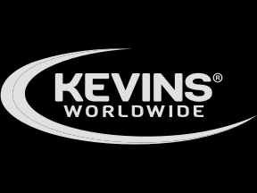




A Better Way to Do Swag
Most companies don’t need more products. They need a better system.
Kevins Worldwide® brings structure, strategy, and support to branded merchandise—turning swag from a scattered process into a streamlined program.
Let’s build a swag store that actually works for your business.
Info@KevinsWW.com
www.KevinsWW.com

